Slide 1
Design and Analysis of Algorithms
CS602
Lecture 8
Greedy paradigm – IV
Homeworks from the optional session.
Shortest paths in graphs with positive weights

Slide 2






A Generic strategy for greedy algorithms
Opt($A$)
$$A$$
instance of size $n$
Greedy
step
?
Opt($A′$)
$$A′$$
instance of size $<n$

Slide 3
A Job scheduling problem
Scheduling to minimize
maximum lateness

Slide 4

Scheduling 2 jobs ?
Lemma 1:(for 2 jobs)
Scheduling ``the earlier deadline job’’ ➔ an optimal solution
time
$$0$$

Slide 5
How to schedule more than 2 jobs ?
Lemma 2:
There is an optimal schedule in which the earliest deadline job is scheduled first.
Consider an optimal schedule
time
$$0$$

Slide 6

How to schedule more than 2 jobs ?
Lemma 2:
There is an optimal schedule in which the earliest deadline job is scheduled first.
time
$$0$$

Slide 7
How to schedule more than 2 jobs ?
Lemma 2:
There is an optimal schedule in which the earliest deadline job is scheduled first.
time
$$0$$

Slide 8
How to schedule more than 2 jobs ?
Lemma 2:
There is an optimal schedule in which the earliest deadline job is scheduled first.
time
$$0$$

Slide 9

How to schedule more than 2 jobs ?
Lemma 2:
There is an optimal schedule in which the earliest deadline job is scheduled first.
time
$$0$$
$$?$$
Homework

Slide 10
Shortest pathS in a graph

Slide 11


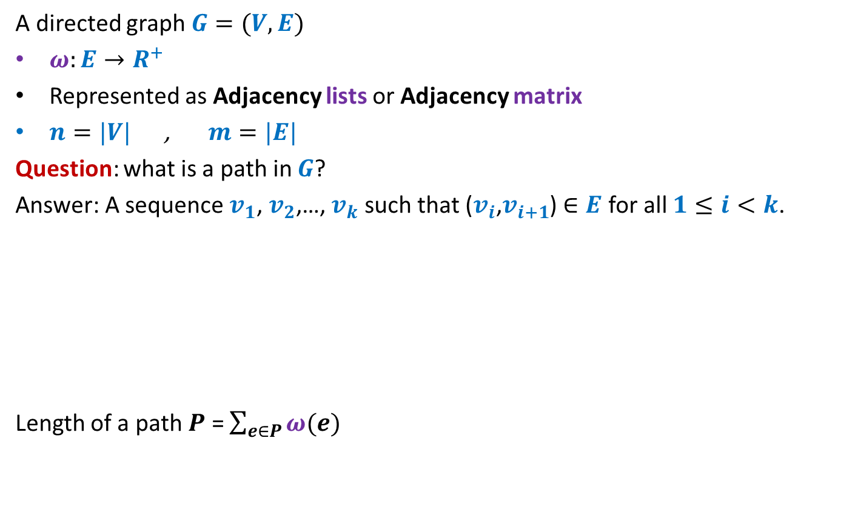



Notations and Terminologies
A directed graph $G=(V,E)$
$ω:E→R^{+}$
Represented as Adjacency lists or Adjacency matrix
$n=|V|$ , $m=|E|$
Question: what is a path in $G$?
Answer: A sequence $v_{1}$, $v_{2}$,…, $v_{k}$ such that ($v_{i}$,$v_{i+1}$) $∈E$ for all $1≤i<k$.
Length of a path $P$ = $\sum_{e∈P}{ω(e)}$
No vertex is repeated
12
3
…
29
$$v_{1}$$
$$v_{2}$$
$$v_{3}$$
$$v_{k−1}$$
$$v_{k}$$

Slide 12
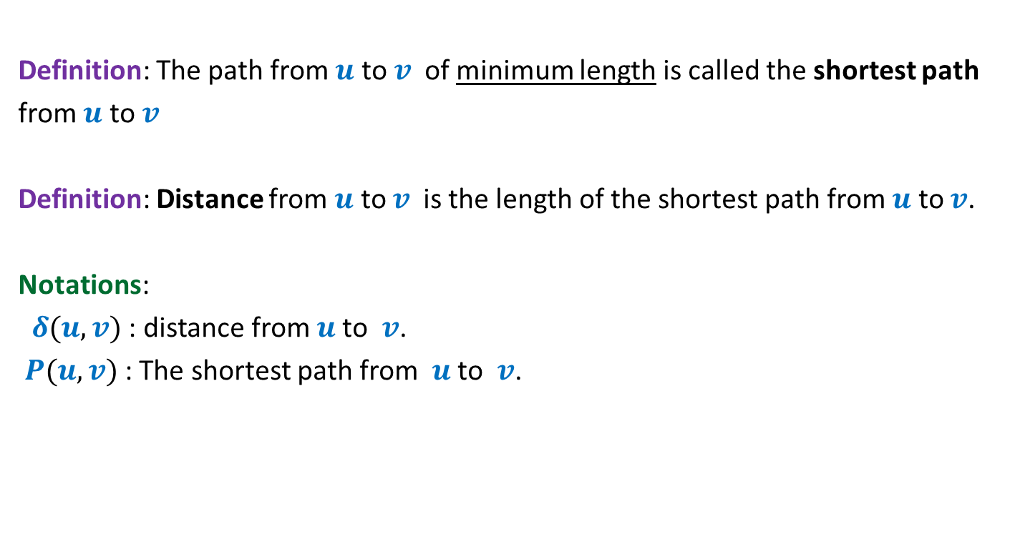
Notations and Terminologies
Definition: The path from $u$ to $v$of minimum length is called the shortest path
from $u$ to $v$
Definition: Distance from $u$ to $v$is the length of the shortest path from $u$ to $v$.
Notations:
$δ(u,v)$ : distance from $u$to $v$.
$P(u,v)$ : The shortest path from $u$to $v$.

Slide 13
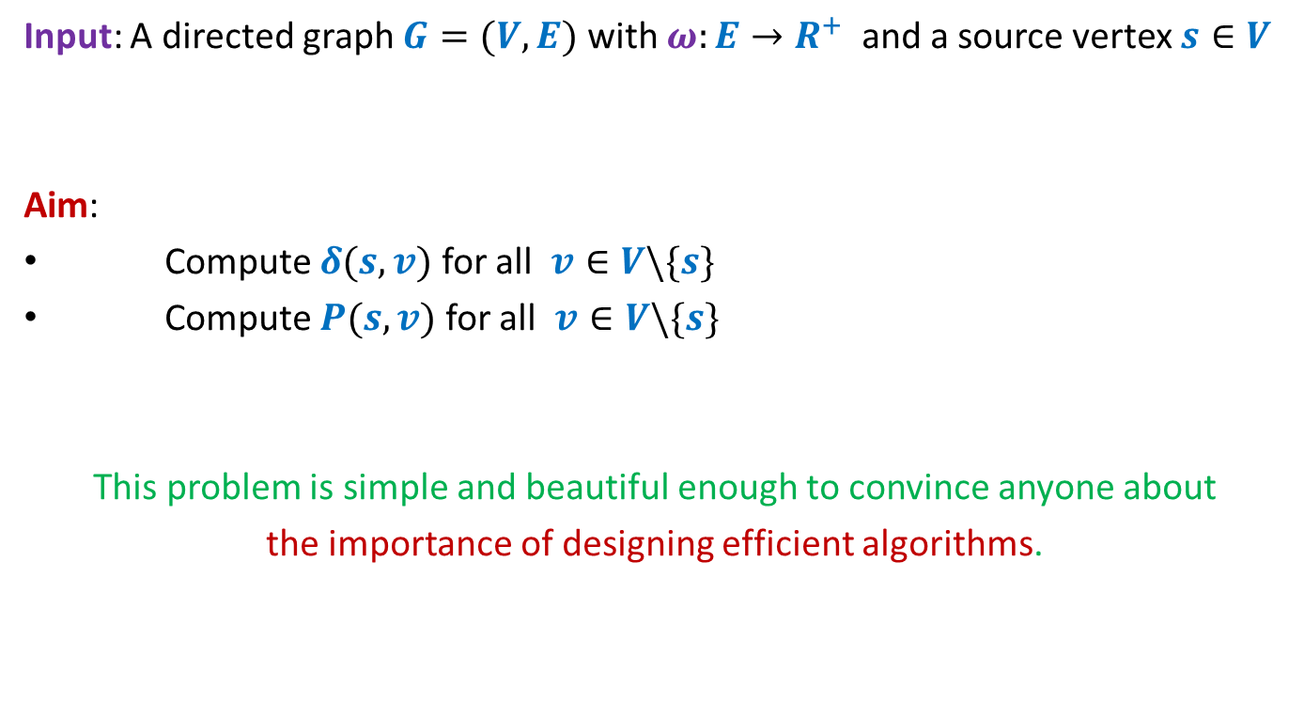
Problem Definition
Input: A directed graph $G=(V,E)$ with $ω:E→R^{+}$ and a source vertex $s∈V$
Aim:
Compute $δ(s,v)$ for all $v∈V\backslash \{s\}$
Compute $P(s,v)$ for all $v∈V\backslash \{s\}$
This problem is simple and beautiful enough to convince anyone about
the importance of designing efficient algorithms.

Slide 14


An example to get an insight into this problem
Inference:
The distance to any vertex depends upon global parameters.
$$q$$
5
7
6
12
G
$$s$$
16
4
9
11

Slide 15


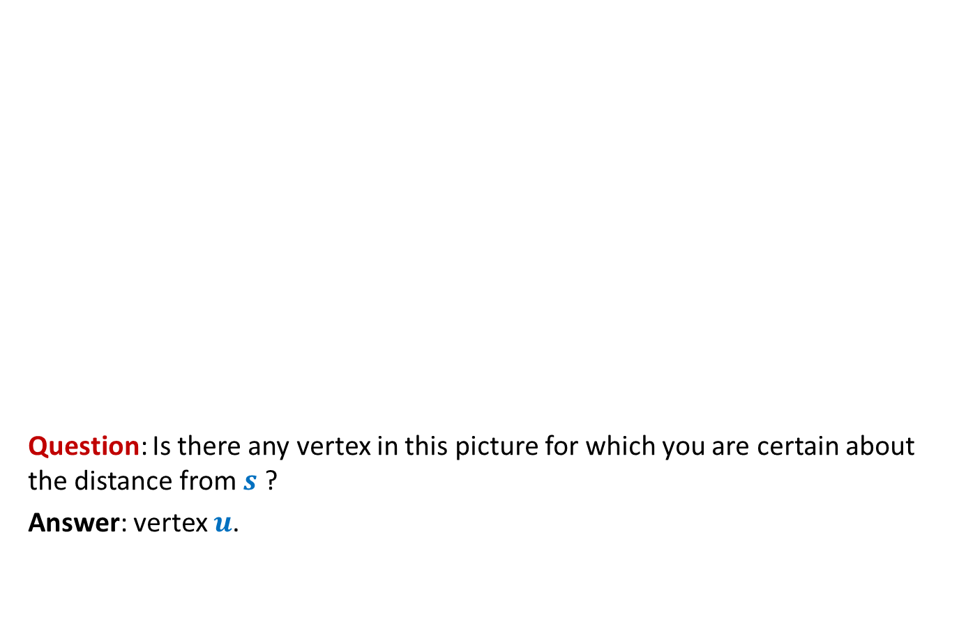



An example to get an insight into this problem
Question: Is there any vertex in this picture for which you are certain about the distance from $s$ ?
Answer: vertex $u$.
$$z$$
10
$$v$$
G
12
7
$$x$$
$$s$$
3
5
$$u$$
$$y$$
Give reasons.

Slide 16


An example to get an insight into this problem
➔ The shortest path to vertex $u$ is edge ($s$,$u$).
$$z$$
10
$$v$$
G
12
7
$$x$$
$$s$$
3
5
$$u$$
$$y$$
$$>0$$

Slide 17






Designing a greedy algorithm for shortest paths
Establish a relation between shortest paths in $G$
and
shortest paths in $G′$
$$G$$
instance of size $n$
Greedy
step
$$G′$$
instance of size $<n$
How will $G′$ look like ?
It was a Homework

Slide 18
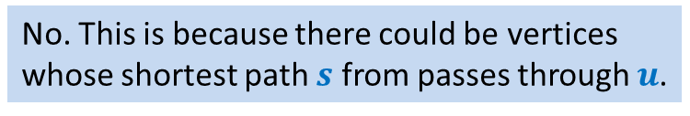
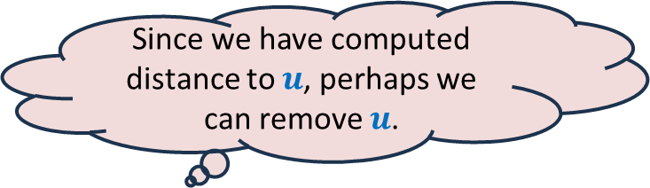




An example to get an insight into this problem
We know the distance to $u$.
Question: Can you remove vertex $u$ without affecting the distance from $s$ ?
$$z$$
$$v$$
10
G
12
7
2
$$x$$
$$s$$
21
$$t$$
3
5
$$u$$
3
8
$$y$$
$$r$$
Since we have computed distance to $u$, perhaps we can remove $u$.
No. This is because there could be vertices
whose shortest path $s$ from passes through $u$.

Slide 19

An example to get an insight into this problem
$$z$$
$$v$$
10
12
7
+3
G’
2
+3
$$x$$
21
$$t$$
$$s$$
5
+3
+3
8
3
$$y$$
$$r$$

Slide 20

An example to get an insight into this problem
Theorem: For each $v∈V\backslash \{s,u\}$,
$$δ_{G}\left(s,v\right)=δ_{G^{′}}\left(s,v\right)$$
$$z$$
$$v$$
10
G’
12
7
5
$$x$$
24
$$t$$
$$s$$
5
6
11
$$y$$
$$r$$

Slide 21
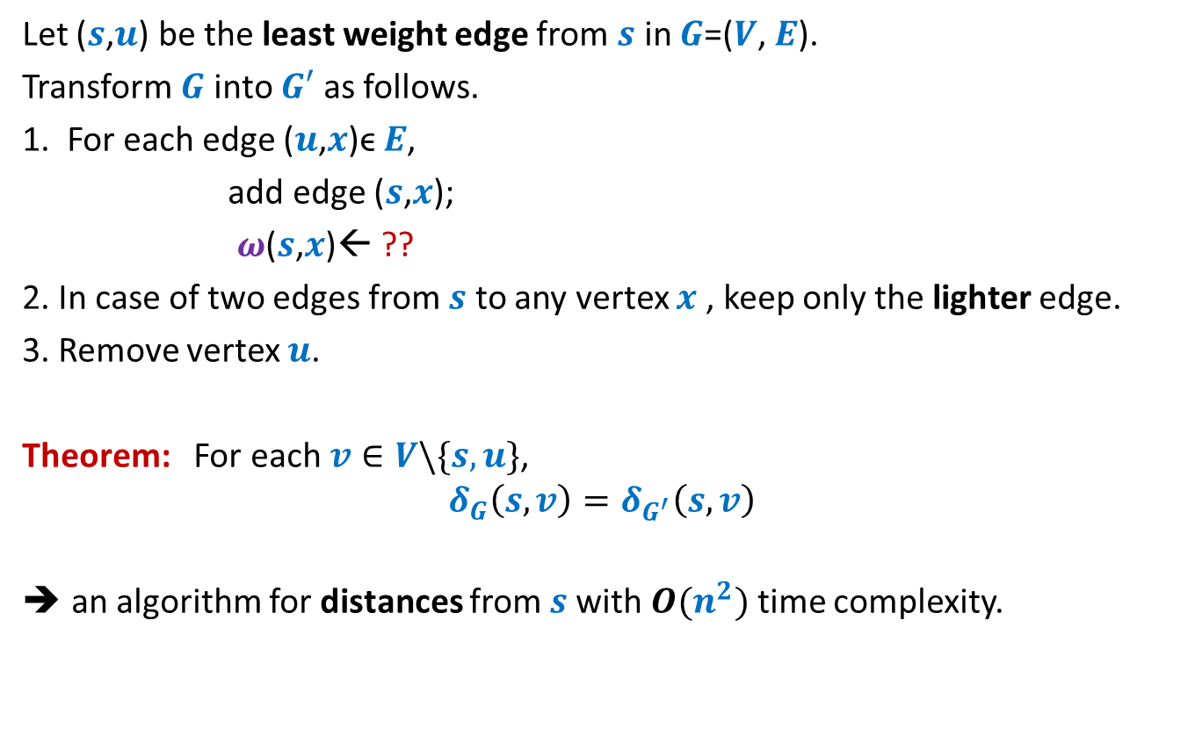


How to compute instance $G′$
Let ($s$,$u$) be the least weight edge from $s$ in $G$=($V$, $E$).
Transform $G$ into $G′$ as follows.
1. For each edge ($u$,$x$)ϵ $E$,
add edge ($s$,$x$);
$ω$($s$,$x$)← ??
2. In case of two edges from $s$ to any vertex $x$ , keep only the lighter edge.
3. Remove vertex $u$.
Theorem: For each $v∈V\backslash \{s,u\}$,
$$δ_{G}\left(s,v\right)=δ_{G^{′}}\left(s,v\right)$$
an algorithm for distances from $s$with $O(n^{2})$ time complexity.
$ω$($s$,$u$) + $ω$($u$,$x$);
Can you see some negative points of this algorithm ?

Slide 22
Shortcomings of the algorithm
No insight into the (beautiful) structure of shortest paths.
Just convinces that we can solve the shortest paths problem in polynomial time.
Very few options to improve the time complexity.
Silent about a compact data structure for storing all shortest paths from the source.
We shall now design a very insightful algorithm based on properties of shortest paths.

Slide 23
Properties of a shortest path

Slide 24






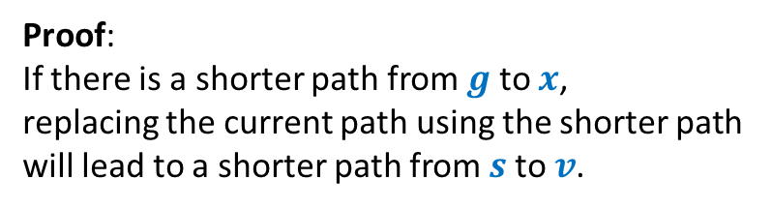


Optimal subpath property
Homework: Write a complete and formal proof for Lemma 1
Consider any shortest path $P(s,v)$.
$δ(s,v)$= 51
Lemma 1: Every subpath of a shortest path is also a shortest path.
Can you realize an assumption made by you in this proof ?
< 27
12
3
7
5
15
9
$$s$$
$$a$$
$$g$$
$$y$$
$$u$$
$$x$$
$v$
?
Proof:
If there is a shorter path from $g$ to $x$,
replacing the current path using the shorter path
will lead to a shorter path from $s$to $v$.

Slide 25




Exploiting the positive weight on edges
Consider once again a shortest path $P(s,v)$.
➔ $δ\left(s,a\right)<δ\left(s,g\right)<δ\left(s,y\right)<δ\left(s,u\right)<δ(s,x)<δ(s,v)$
This leads to an alternate proof to the following assertion ☺:
The nearest vertex of $s$ must be $s$’s neighbor.
$$>0$$
$$>0$$
$$>0$$
$$>0$$
$$>0$$
$$>0$$
$$s$$
$$a$$
$$g$$
$$y$$
$$u$$
$$x$$
$v$
(1)

Slide 26




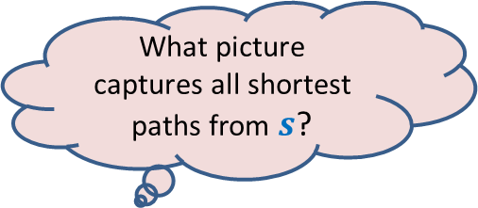


More insights …
What can we say about $x$ ?
Let $s_{i}$ : $i$th nearest vertex from $s$.
$s_{0}$ = $s$.
Consider the shortest path $P\left(s,s_{i}\right)$.
Lemma 2: $P\left(s,s_{i}\right)$ must be of the form $s ⇝$ $s_{j} →s_{i}$ for some $j<i$.
$x$ must be $s_{j}$ for some $j<i$.
$$s$$
$$x$$
$s_{i}$
shortest
What picture captures all shortest paths from $s$?

Slide 27








Complete picture of all shortest paths ?
Shortest paths tree
$$s$$
$$s_{4}$$
$$s_{1}$$
$$s_{7}$$
$$s_{5}$$
$$s_{2}$$
$$s_{3}$$
$$s_{6}$$

Slide 28
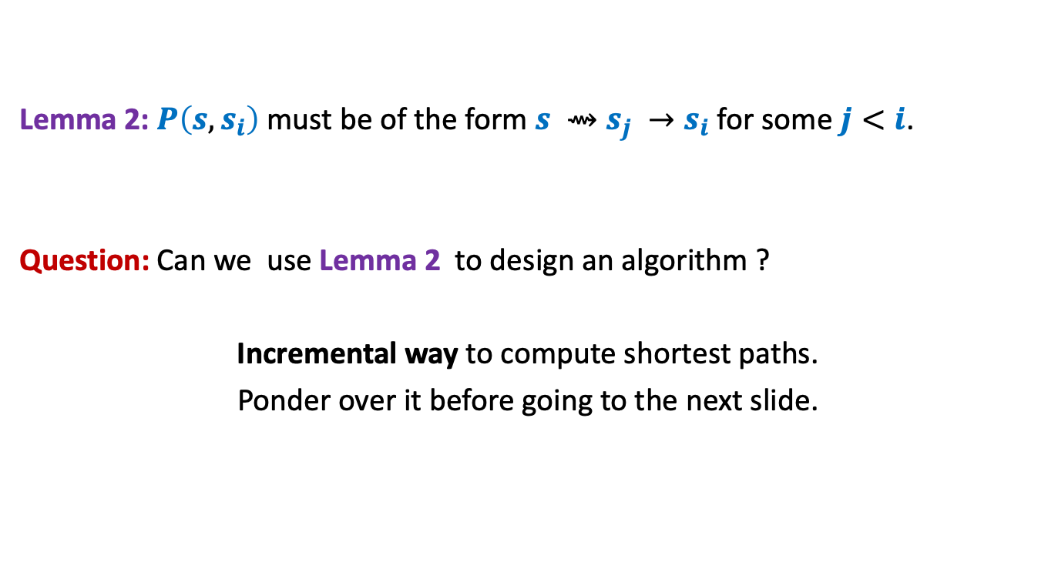
Designing the algorithm …
Lemma 2: $P\left(s,s_{i}\right)$ must be of the form $s ⇝$ $s_{j} →s_{i}$ for some $j<i$.
Question: Can we use Lemma 2 to design an algorithm ?
Incremental way to compute shortest paths.
Ponder over it before going to the next slide.
shortest

Slide 29



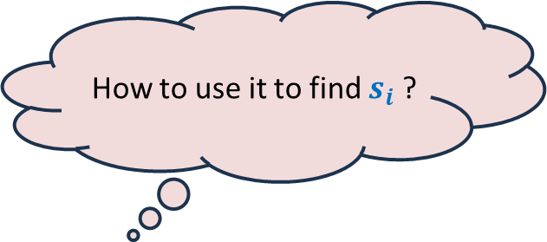

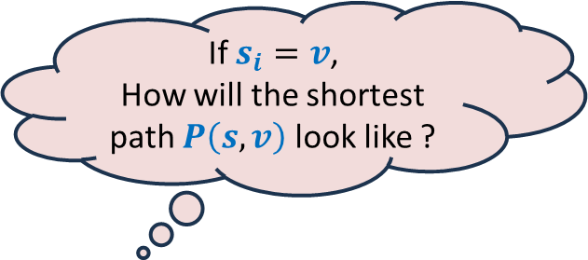
Suppose we have computed $s_{0}$, $s_{1}$,…, $s_{i−1}$.
How to find out $s_{i}$ ?
Using Lemma 2
Consider any $v∈V \backslash \{s_{0}\text{,} s_{1}\text{,…,} s_{i−1}\}$
Or
Or
$$s$$
G
$$s_{1}$$
$$s_{4}$$
$$v$$
$$s_{2}$$
$$s_{3}$$
If $s_{i}=v$,
How will the shortest path $P\left(s,v\right)$ look like ?
How to use it to find $s_{i}$ ?
Let us define a function $L\left(v\right)$
We need to just focus on
the edges incident on $v$ from $s_{0}$, $s_{1}$,…, $s_{i−1}$.
Isn’t it nice ☺ ?
Ponder over its usefulness before proceeding further.

Slide 30


Suppose we have computed $s_{1}$, $s_{2}$,…, $s_{i−1}$.
How to find out $s_{i}$ ?
For each $v∈V \backslash \{s_{1}\text{,} s_{2}\text{,…,} s_{i−1}\}$
$$L\left(v\right)=$$
$s_{i}$ is ??
Using Lemma 2
88
101
$$s$$
G
51
$$s_{1}$$
$$s_{4}$$
82
$$v$$
76
$$s_{2}$$
90
$$s_{3}$$
62
$$\left(δ\left(s,s_{j}\right)+ω\left(s_{j},v\right)\right)$$
$$\min_{\left({(s}_{j},v\right)∈E)}{ ? }$$
the vertex with minimum value of $L$.
How to find $s_{i}$ ?

Slide 31



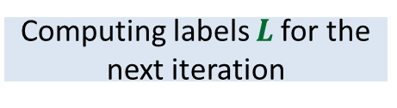
Dijkstra’s algorithm
Dijkstra-algo($s$,$G$)
$U$ ← $V$;
$L\left(s\right)$← $0$;
For $i$ = 0 to $n−1$ do
{ $y$← vertex from $U$ with minimum value of $L$;
$δ\left(s,y\right)\text{←}L\left(y\right)$;
move $y$ from $U$ to $S$;
For each $v∈U$ do
{ $L\left(v\right)$← $∞$;
For each $(x,v)∈E$ with $x∈S$do
$L\left(v\right) \text{←}$ min( $L\left(v\right)$, $δ\left(s,x\right)+ω\left(x,v\right)$ )
}
}
Only neighbors of $y$
$L\left(v\right)$← $∞$ for all $v∈U$ ;
Computing labels $L$for the next iteration
What are the vertices
whose $L$ value may change
in this iteration ?
a lot of re-computation

Slide 32

Dijkstra’s algorithm
Dijkstra-algo($s$,$G$)
$U$ ← $V$;
$L\left(s\right)$← $0$;
For $i$ = 0 to $n−1$ do
{ $y$← vertex from $U$ with minimum value of $L$;
$δ\left(s,y\right)\text{←}L\left(y\right)$;
move $y$ from $U$ to $S$;
For each $(y,v)∈E$ with $v∈U$do
{
$L\left(v\right) \text{←}$ min( $L\left(v\right)$, $δ\left(s,y\right)+ω\left(y,v\right)$ )
}
}
$L\left(v\right)$← $∞$ for all $v∈U$ ;
1 extract-min operation
deg($y$) Decrease-key operations

Slide 33
Homework
What data structure is to be used to efficiently implement the Dijkstra’s algorithm?
Write a neat pseudocode in terms of the data structure.
What is the time complexity of the implementation ?

